Slide 1
Running an LLM locally, Can I do that?
QUT Digital Observatory
ResBaz 2024 - ACU

Slide 2
Outline
Why?
Sensitive data
CPU, GPU and RAM
Environments
Interfacing
Demo

Slide 3
Why would you want to run an LLM locally Anyway
Cost
Transparency
Repeatability
Fine Tuning

Slide 4

Sensitive data
Data that you need to be in control of
Where does it go?
Who has “access” to it in transit
Who has “access” to it while its being processed
Can it leave your network?
Can it leave your laptop?

Slide 5

Limitations and considerations

Slide 6
The following slides are only here to help you ask for the best options for you when you talk to your e-research/IT teams

Slide 7
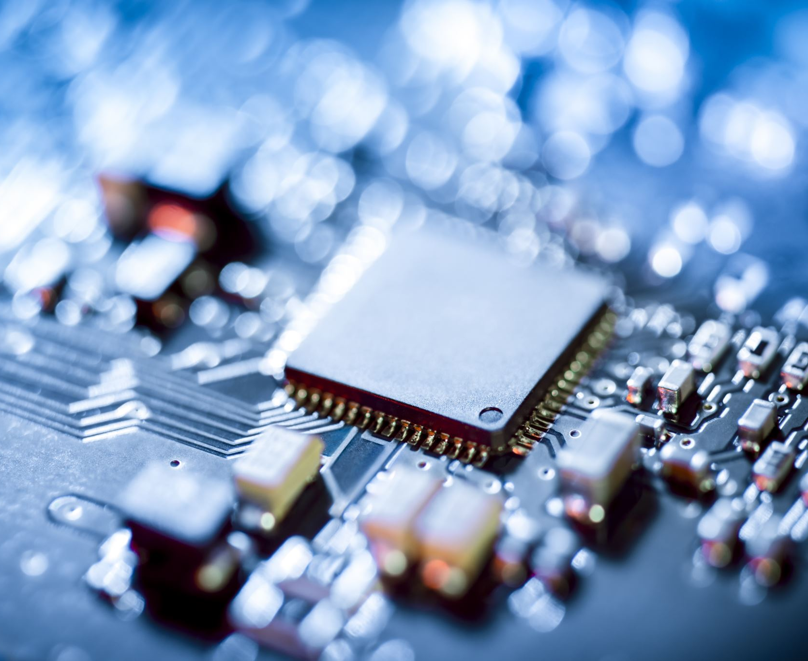
CPU and GPU
GPUs:
Faster inference due to massive parallelism.
Higher operational costs, best suited for intensive applications.
CPUs:
Lower costs, effective for smaller-scale inference tasks.
Compromises on speed, better for non-time-sensitive applications.
GPU: Faster, more capable for real-time and demanding tasks.
CPU: Economical but limited in speed and efficiency.

Slide 8

RAM
More VRAM:
Enables larger models and faster inference, with fewer memory bottlenecks.
Handles more complex queries efficiently with minimal overhead.
Limited VRAM:
May require model optimization (e.g., quantisation) to fit into smaller VRAM.
Increases reliance on system RAM or offloading, which can decrease speed and lead to higher latency.
High VRAM: Smoother, faster inference with high-capacity models.
Low VRAM: Requires techniques like model compression, but often at the cost of performance.

Slide 9
System Memory Rules of Thumb
Total RAM needed ≈ 1.5-2x model size
7B model → 16GB RAM minimum
13B model → 32GB RAM minimum
Larger means slower if under-resourced

Slide 10
GPU Memory (VRAM)
Basic Models
8GB VRAM: Can run 7B models (4-bit)
12GB VRAM: Good for most 7B models
24GB+ VRAM: Comfortable for 13B models
Rule: Check model size before downloading!

Slide 11
Practical Tips
Use model quantisation (4-bit, 8-bit)
Reduces memory needs
Small performance trade-off
Swap Space
Set to 2x RAM for safety
Slower but prevents crashes
SSD better than HDD for swap
Notes:
Understanding Memory Tricks
Quantization
Makes models smaller and faster
Original model: High precision numbers (16-bit)
Quantized model: Smaller numbers (4-bit or 8-bit)
Like rounding 3.14159 to 3.14
Uses less memory
Slightly less accurate
Much more practical for laptops
Swap Space
Like an extension of your RAM using your hard drive
RAM = Fast but small
Hard Drive = Slow but big
When RAM gets full:
Moves less-used stuff to hard drive
Makes room for active work
System stays running, just slower
Setting up swap:
Usually 2x your RAM size
SSD works much better than HDD
Emergency backup, not main memory
Bottom Line
Quantization: Run bigger models on less VRAM
Swap Space: Safety net for memory limits
Together: Make LLMs work on regular computers

Slide 12
Keep in Mind
Better to run smaller model well
CPU-only is possible but very slow
Check requirements before installing

Slide 13
Deployment Environments
High-Performance Computing (HPC) Clusters
Dedicated Network Hardware
Windows (with WSL or RStudio)
Cloud-Hosted Solutions*

Slide 14

HPC Deployment Options

Slide 15
Access Types
University Computing Centers
National Research Infrastructure

Slide 16
Execution Modes
Interactive Sessions
Direct model interaction
Development and testing
Batch Processing
Production workloads
Large-scale inference

Slide 17
Resource Management
Job Schedulers
SLURM, PBS
Queue policies
Priority systems
Hardware Allocation
GPU/CPU quotas
Memory limits
Runtime restrictions

Slide 18
High Performance Computing
University hosted high performance computing system
*National Infrastructure hosted high performance computing systems
On local network
Interactive versus Batch
Scheduler software (PBS, Slurm)
Actual limits on hardware requests

Slide 19
Dedicated hardware on the local network
Specialist computer attached to the local network
VRAM ++ GPU
Local network connection
Remote operations

Slide 20
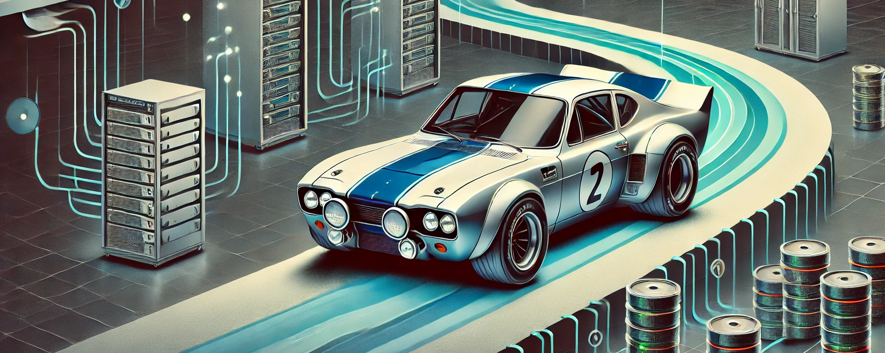
Dedicated Network Hardware

Slide 21
Hardware Configuration
High-End GPU Systems
VRAM requirements (24GB+)
Consumer vs Data Center GPUs
System Memory
RAM to VRAM ratios
Swap considerations

Slide 22
Network Integration
Local Network Attachment
Ethernet/InfiniBand options
Network bandwidth requirements
Access Control
Internal IP restrictions
User authentication

Slide 23
Remote Operations
SSH/Remote Desktop Access
API Endpoints
Load Balancing
Resource Monitoring

Slide 24
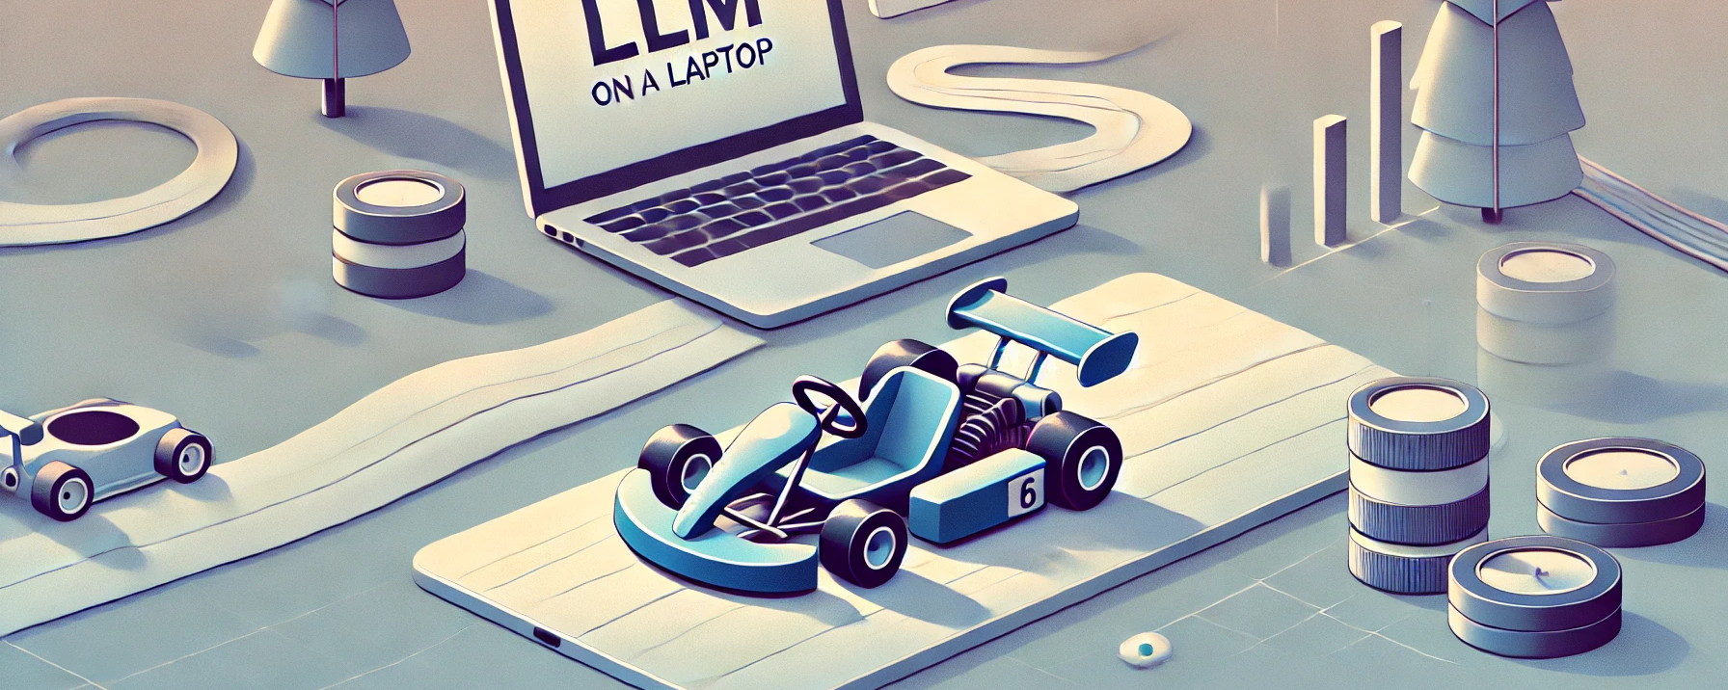
Running LLMs on Windows Laptops

Slide 25
Basic Setup
Windows 10/11
WSL2 (Windows Subsystem for Linux)
Easy Ubuntu install
Works like Linux, feels like Windows

Slide 26
Development Tools
VS Code
Python coding
Easy WSL connection
Good for most tasks
RStudio
R language work
Data analysis

Slide 27
Hardware Note
Check your GPU memory
Some models need lots of RAM
Smaller models work better on laptops

Slide 28
Windows/WSL - RStudio
Base OS is Windows
Windows Subsystem for Linux
VS Code for python (and R)
R Studio for R

Slide 29
Linux
Base OS is Linux
VS Code

Slide 30
Cloud Hosted Systems***
AWS
GCP
Azure

Slide 31

Cloud Hosting Options

Slide 32
Major Platforms
AWS, GCP, Azure
Ready-made infrastructure
Pay-as-you-go pricing

Slide 33
Key Considerations
Data Security
Private cloud options
Virtual Private Networks
Data residency compliance
Cost Management
GPU instances are expensive
Easy to forget running instances
Reserved vs on-demand pricing

Slide 34
Common Challenges
Complex permissions/access control
Network setup can be tricky
Need cloud expertise
Central IT often manages access

Slide 35
When to Consider
Need scalability
Don't want to manage hardware
Have approved cloud budgets
Data security requirements are met

Slide 36
Systems
Ollama
OpenAI
WSL

Slide 37
Interfacing with the LLM
A lot of systems have adopted an “open-ai” like way of passing prompts to models
So, lets look under the hood a bit for what we are doing and how we are driving the local models.

Slide 38
Open AI Patterns
from openai import OpenAI
client = OpenAI()
completion = client.chat.completions.create(
model="gpt-4o",
messages=[
{"role": "system", "content": "You are a helpful assistant."},
{"role": "user", "content": "Hello!"}
]
)
print(completion.choices[0].message)

Slide 39
Return JSON
{
"id": "chatcmpl-123",
"object": "chat.completion",
"created": 1677652288,
"model": "gpt-4o-mini",
"system_fingerprint": "fp_44709d6fcb",
"choices": [{
"index": 0,
"message": {
"role": "assistant",
"content": "\n\nHello there, how may I assist you today?",
},
"logprobs": null,
"finish_reason": "stop"
}],
"usage": {
"prompt_tokens": 9,
"completion_tokens": 12,
"total_tokens": 21,
"completion_tokens_details": {
"reasoning_tokens": 0
}
}
}

Slide 40
Many ways to do this
I’m going to demonstrate 2 ways of doing this
Ollama + WSL + VScode + Python
LM Studio + Windows + R Studio + R

Slide 41

Git Repo

